Slide 1
Academic Security SIG
Liliana (Nina) Solha (RNP, Brazil)
Roderick Mooi (SANReN, South Africa)

Slide 2
Academic Security SIG
Strategies to improve security in R&E
Common challenges
Experiences
Worldwide platform for collaboration of Academic and Research security incident response teams
Primary target public:
NREN & University CSIRTs
Research & Education CSIRTs in general
Resources:
SIG mailing list (57 subscribers)
SIG page @FIRST Portal (members-only)
SIG meetings (FIRST Zoom plataform)

Slide 3
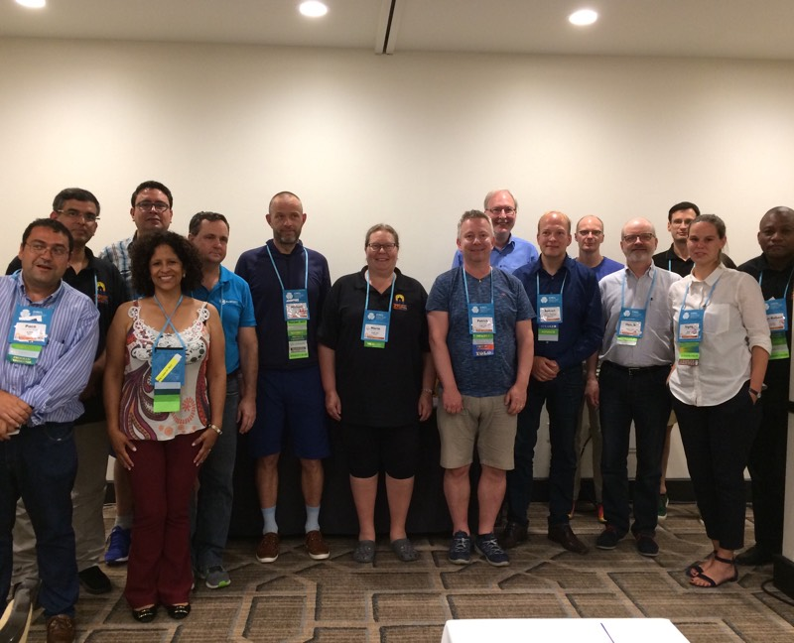
Academic Security SIG
Meeting up with members...

Slide 4
Academic Security SIG
The SIG in a timeline...
2018
02 virtual SIG meetings
2019
01 F2F SIG meeting @FIRSTCON
2020
2021
01 F2F SIG meeting @FIRSTCON
01 F2F SIG Update @FIRSTCON
01 virtual SIG meeting
01 virtual SIG Update @SIGUpdateWebinars
01 virtual SIG meeting (February)
01 virtual SIG Update @SIGUpdateWebinars
02 virtual SIG meetings (planned)

Slide 5
2021: New SIG Working Groups
Please select up to 5 (five) initiatives you would like the SIG to focus on.
SIG should focus on:
Cyber threat intelligence
Academic CSIRTs/SOCs
Cooperation with other similar regional and global initiatives
Training and awareness
Incident response coordination
85,71%
85,71%
71,43%
64,29%
57,14%

Slide 6
2021: New SIG Working Groups
Please select up to 5 (five) initiatives you would like the SIG to focus on.
SIG should focus on:
Cyber threat intelligence
Academic CSIRTs/SOCs
Cooperation with other similar regional and global initiatives
Training and awareness
Incident response coordination
85,71%
85,71%
71,43%
64,29%
57,14%

Slide 7
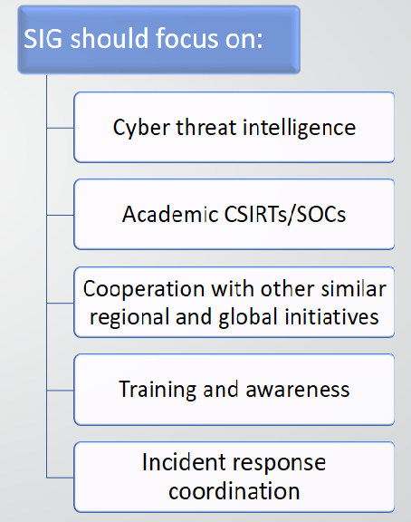
Academic Security SIG
Next steps
Looking for a “volunteer” for Academic CSIRTs/SOCs WG
1
Description
Scope
Goals/objectives
Deliverables
Timeline
FIRST Academic Security SIG Meeting
June 15 – (15:00-17:00 CEST)
2
3
Cooperation with other SIGs

Slide 8
Academic Security SIG – how to join?
https://www.first.org/global/sigs/academicsec
Participation policy:
Open but generally restricted to academic CSIRTs (research & education, NREN, University, etc.)
Non-academic CSIRTs at the discretion of the chairs. Note: it is not a requirement to be a FIRST member to participate in the SIG though we do encourage it.
Request to Join Form (FIRST members only)
https://portal.first.org/g/Academic%20Security/join
Chairs contact: <academicsec-chairs@lists.first.org>

Slide 9
Thank you!
Liliana Solha (RNP)
Roderick Mooi (SANReN)
academicsec-chairs@lists.first.org

